Slide 1
A Beginner’s Tutorial for Jupyter Notebook
Yujia Xu
Center for Robotics Research
Department of Engineering
King’s College London
Email: yujia.xu@kcl.ac.uk

Slide 2
Table of Contents
Introduction
Precondition
Jupyter Installation
Notebook Creation and Management
Interact with Python Kernels
Project Demos
Jupyter Extensions

Slide 3
Introduction
What is Jupyter Notebook?
An effective interactive web application for developing and presenting live projects, making your work more understandable and shareable.
What can it do?
Running scripts
Adding rich text description (e.g. text, figure, equation, etc.)
Data Analysis
Interaction with your data
Record your experimental processes
Significance:
A necessary skill in data science industry.
Better visualize and analyze your data.
Present your work better to others.
Manage your projects and record your experimental history.

Slide 4


Pre-condition
To install and use Jupyter Notebook, there are some required tools:
(Can be referred later, we explore Jupyter online in this tutorial.)
Programming language:
*Python (3.0+), R, etc.
Tools for installation:
Pip: Package installer and manager.
Anaconda: (Recommended) include all the functions of pip, but also capable of managing multiple developing environments.

Slide 5



Pre-condition
Make sure you have installed Python3 and Anaconda in your local machines,
And added them into your system path.
Interpreter
Packages
. . .
Anaconda
Configures
Environments

Slide 6
Jupyter Installation
Anaconda
Install Anaconda to your local machines
Windows: https://repo.anaconda.com/archive/Anaconda3-2020.11-Windows-x86_64.exe
Linux: https://repo.anaconda.com/archive/Anaconda3-2020.11-Linux-x86_64.sh
Mac: https://repo.anaconda.com/archive/Anaconda3-2020.11-MacOSX-x86_64.pkg
*Ensure Anaconda has been appended to your system path.
2. Create a developing environment and Activate it
conda create -n ENVIR_NAME python=VERSION
conda activate ENVIR_NAME
3. Install some necessary packages (Libraries) for your experiments
single package: conda install PACKAGE_NAME
With specific version: conda install PACKAGE_NAME=VERSION
Multiple packages: conda install PACKAGE_NAME1, PACKAGE_NAME2
E.g., conda install matplotlib=1.4.3 scikit-learn=0.24.1 numpy=1.19.2
4. Install Jupyter to your conda environment
conda install –c conda-forge notebook

Slide 7
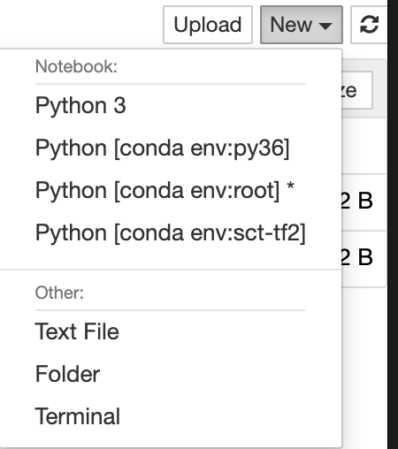
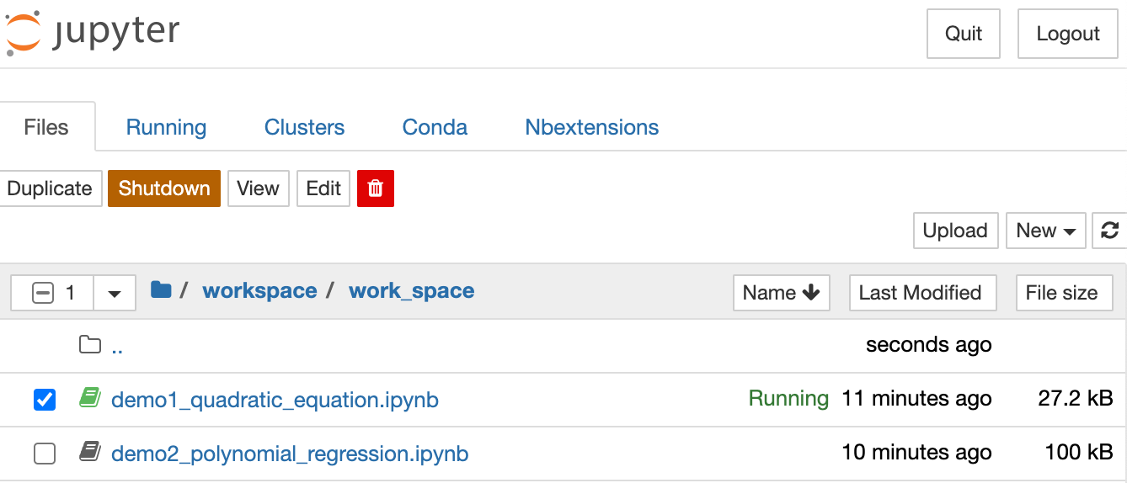
Notebook Creatation and Management
Launch Jupyter Via Command
Command line: jupyter notebook --port=PORT (default port: 8888)
Open Jupyter in Browser
Http://localhost:PORT/
Notebook operations
Working dictionary
Choose a Python Kernel to create a notebook instance
Notebook List

Slide 8
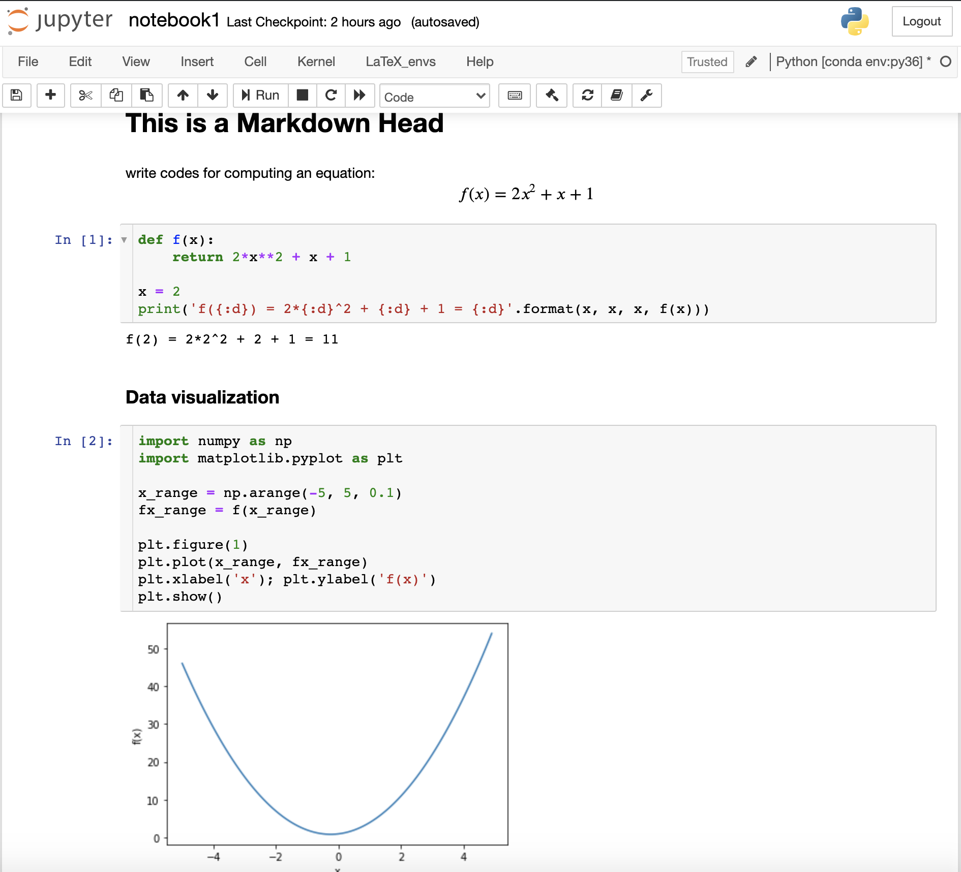
Interactive with Python Kernels
Toolbar
Text Description
Latex Equation
Python scripts
Advantages over Directly Running Python Scripts:
Make things more clear
More sharable to others
Run cell by cell, stop anywhere
Better visualization and analysis
Rich extensions
Data Visualization

Slide 9
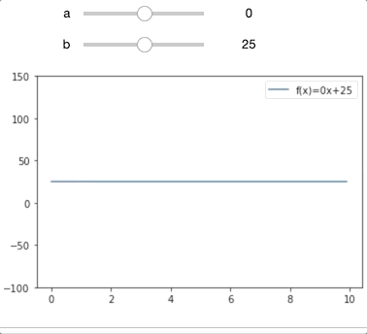
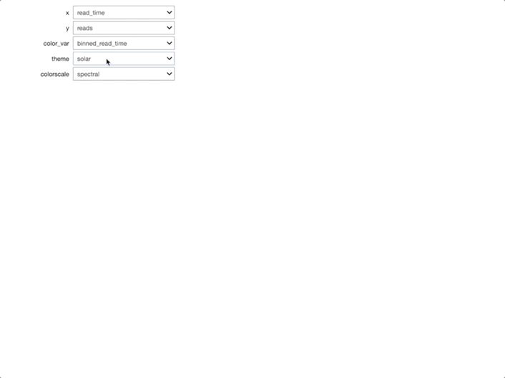
Interactive Components in Jupyter
Plot live lines
Draw line scatter diagram
(From WillKoehrsen/Data-Analysis on Github)

Slide 10
Jupyter Demos
Demo List:
Quadratic equation solving with interaction and plotting features.
Polynomial Regression and Results Visualization
(Exercise) Computing Eigenvalues of Matrix
(Optional) IRIS Flower Classification Project
Try Jupyter Online without any other requirements.
https://jupyter.org/

Slide 11
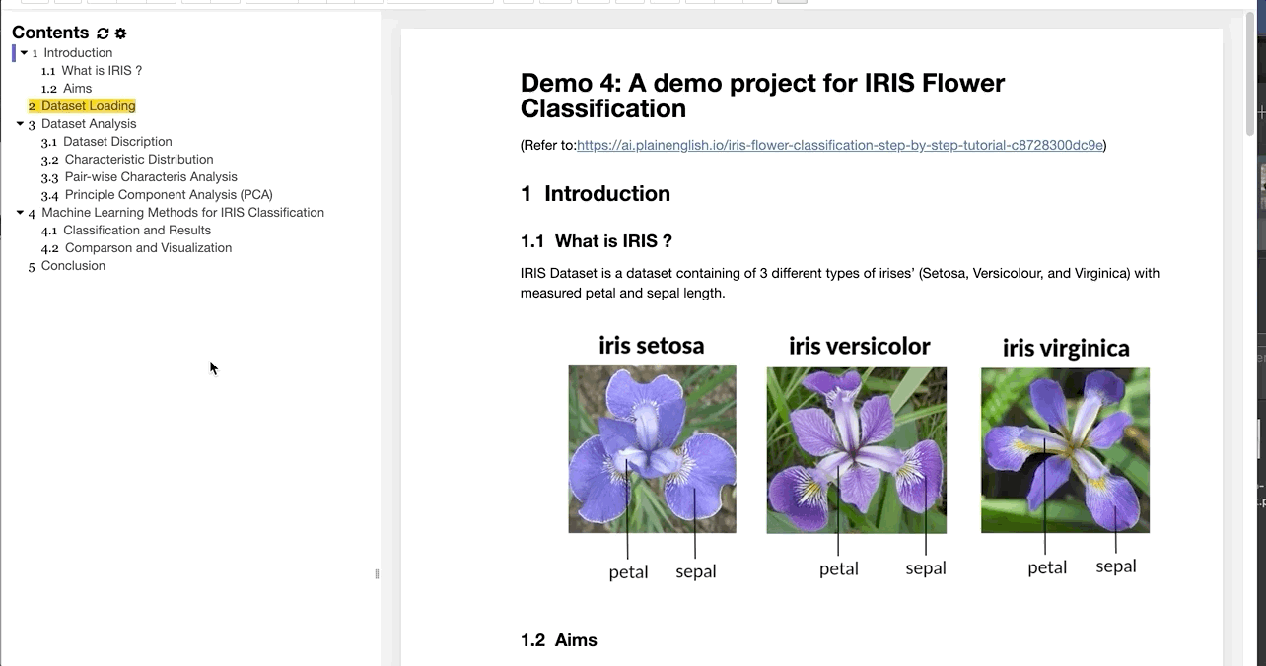
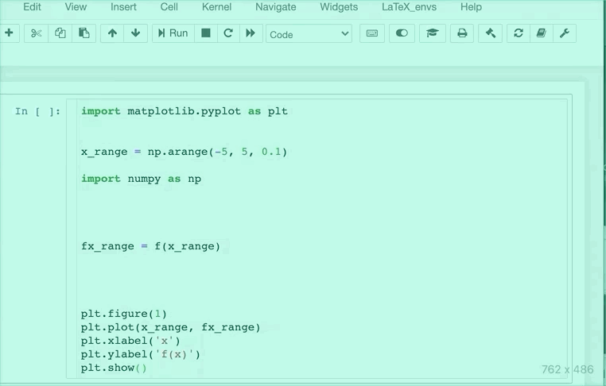
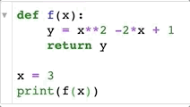
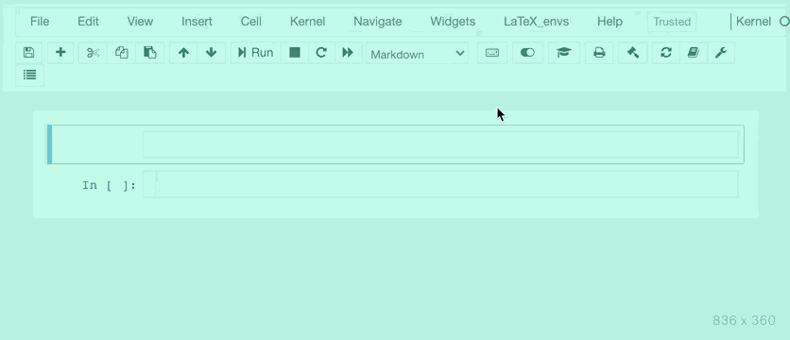
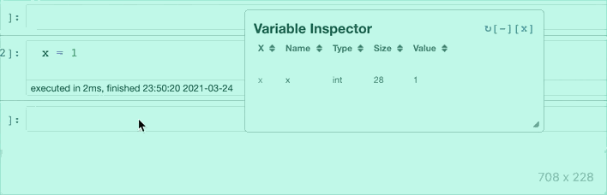
Jupyter Extensions
Extensions make Jupyter a promising tool.
Code folding
Table of Contents
Prettifies Your Code
Variable Inspector
Formula Annotation

Slide 12
Thanks for listening
Speaker ： Yujia Xu

